Slide 1
Brazil and the Global Bioeconomy
Carlos Aragão (1) & Rodnei Dias (2)
(1) Naval Agency for Nuclear Safety and Quality
(2) Inmetro- Brazilian NMI
TWAS-Lacrep Young Scientists Conference, August 20, 2018

Slide 2
Summary:
Nicholas Georgesçu-Roegen, bioeconomy and the new approach from OECD;
Bioeconomy in the world;
Some numbers of the bioeconomy in Brazil.

Slide 3
Nicholas Georgesçu-Roegen, bioeconomy and the
new approach from OECD

Slide 4
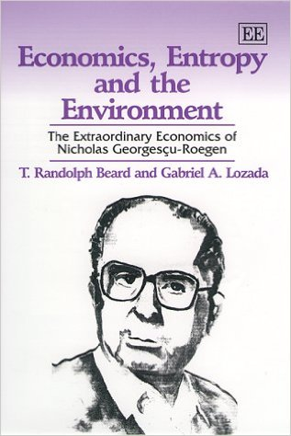
Nicholas Georgesçu-Roegen (1906-1994) argued that the economy was actually a giant thermodynamic system in which entropy increases inexorably and our material basis changes.

Slide 5
He argued that if we continued to produce with the techniques we have developed, then our society and the Earth would disappear faster than if we introduced small-scale production, resource-saving technologies, and limited consumption.
However...

Slide 6
In the last four decades, the perception of the role of a bioeconomy has greatly changed:
Many biotechnological innovations in areas like human health, agriculture, and livestock have changed this initial vision.

Slide 7
Thus, these biotechnological innovations can support sustainable development by:
improving the environmental efficiency of primary production and industrial processing; and
helping to repair degraded soil and water.
Source: OECD (2009)

Slide 8
Bioeconomy
in the world

Slide 9
OECD: Until 2030, the biotechnology global share will be US$ 1 trillion/year:
  Health – US$ 260 billion;
  Primary production – US$ 380 billion
  Industrial – US$ 420 billion
80% of medicine will be pharmaceutically produced by biotechnologies

Slide 10
Biotechnology today is used in primary production, health, and industry.
    Genetic modification;
    DNA sequencing;
    Bioinformatics;
    Metabolic pathway engineering.

Slide 11
Human health applications
  Therapeutics;
  Diagnostics;
  Pharmacogenetics to improve prescription practices;
  Functional foods and nutraceuticals; and
  Some medical devices.

Slide 12
Industrial applications to produce:
  Chemicals, plastics, and enzymes.
  Environmental applications such as:
        Bioremediation and biosensors;
        Methods to reduce the environmental effects or costs of resource extraction; and
        Production of biofuels.

Slide 13
Other applications:
  Biopharmaceuticals;
  In vitro diagnostics;
  Some types of genetically modified crops;
  Enzymes, which are comparatively “mature” technologies; and
  Regenerative medicine and health therapies based on RNA interference.

Slide 14
Approved GM crop planting, 2007
Source: OECD (2009)

Slide 15
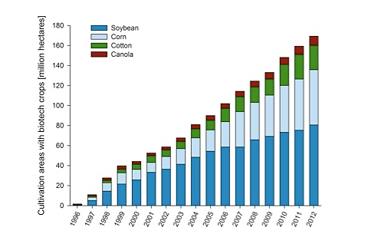
Global cultivation of genetically
modified plants from 1996 till 2012
Source: Patrick Guertler, adapted from Clive James (2012)

Slide 16
Global Area of Biotech Crops in 2012
Rank | Country | Area (million hectares) | Biotech Crops
1 | USA | 69.5 | Maize, soybern, cotton, canola, sugarbeet, alfalfa, papaya, squash.
2 | Brazil | 36.6 | Soybean, maize, cotton.
3 | Argentina | 23.9 | Soybean, maize, cotton.
4 | Canada | 11.6 | Canola, maize, soybean, sugarbeet
5 | India | 10.8 | Cotton
6 | China | 4.0 | Cotton, papaya, poplar, tomato, sweet pepper.
7 | Paraguay | 3.4 | Soybean, maize, cotton.
8 | South Africa | 2.9 | Maize, soybean, cotton.
9 | Pakistan | 2.8 | Cotton
10 | Uruguay | 1.4 | Soybean, maize.
11 | Other | 3.4 | Soybean, maize, cotton, canola.
Total |  | 170.3
Source: Clive James (2012)

Slide 17
Share of biopharmaceutical NMEs (new pharmaceutical compounds or new molecular entities) out of all pharmaceutical NMEs by year of first registration for market approval, 1989-2007
Source: OECD (2009)

Slide 18
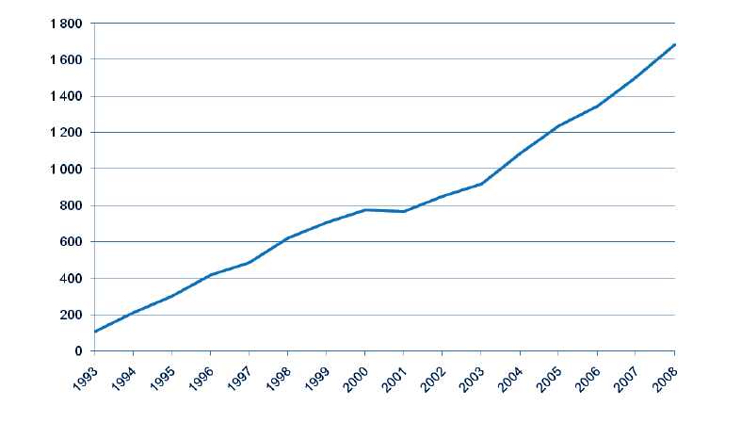
Number of diseases for which genetic testing is available as reported to GeneTests, by year
Source: OECD (2009)

Slide 19



Evolution of Biotechnology & Equipments Markets
2011 to 2016, est., $ Billions
2011
2016 est.
300,0
+107%
+136%
145,0
+367%
+160%
Biotherapeutics overall
Upstream (bioproduction)
Total SUT market
R&D-support single-use systems
Sources : contractpharma.com

Slide 20
The market share of biopharmaceuticals is growing but is controlled by only a few key companies
Evolution of the Pharmaceutical Market
– Billion USD, 2001-2011
Biopharmaceutical Global Production Capacity – Share of production capacity, 2011
855
889
Biopharmaceuticals
Others
Rest of Pharma
812
128
(15%)
139
(16%)
Roche
770
117
(14%)
727
106
(14%)
25%
684
95
(13%)
641
82
(12%)
599
69 (11%)
523
560
59 (10%)
Novartis
5%
489
46 (9%)
51 (9%)
38 (8%)
5%
Eli Lilly
Johnson
& Johnson
Sanofi
Boehringer
Ingelheim
Pfizer
Lonza
Amgen
2001
2002
2003
2004
2005
2006
2007
2008
2009
2010
2011
Sources : GiResearch

Slide 21
Projected value of world chemical production:
2005, 2010 and 2025

Slide 23

Synthetic biology in the world

Slide 24
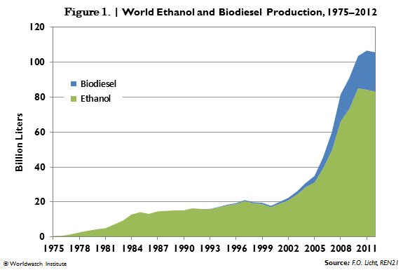
World Ethanol and Biodiesel Production: 1975-2012

Slide 25
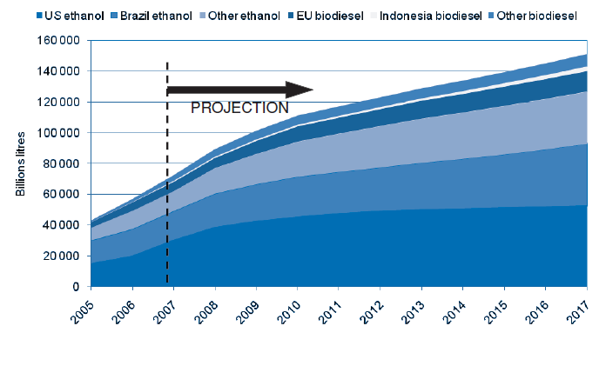
World ethanol and biodiesel production: projections
Source: OECD (2009)

Slide 26
Some numbers of the bioeconomy in Brazil

Slide 27
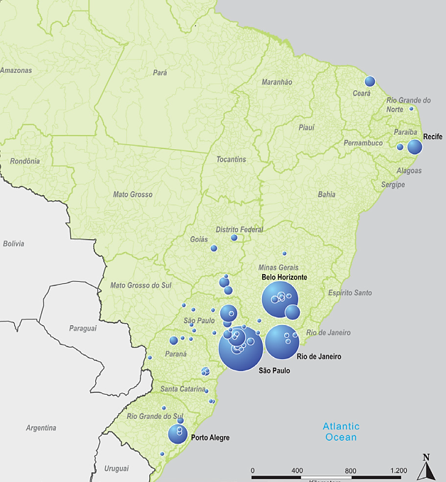

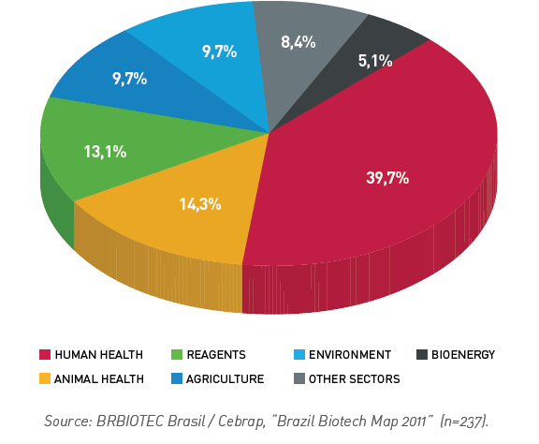
Distribution of the Biotechnology Industry in Brazil
Biotechnology companies by area of activity

Slide 28
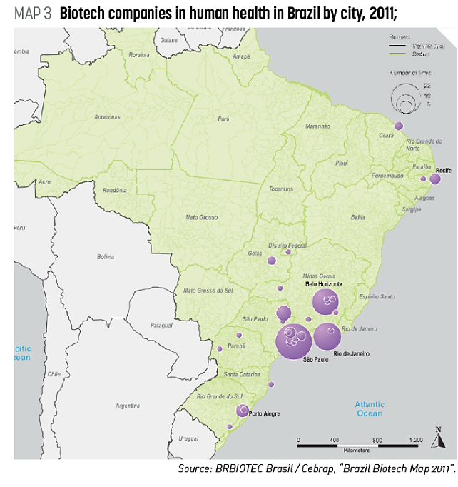

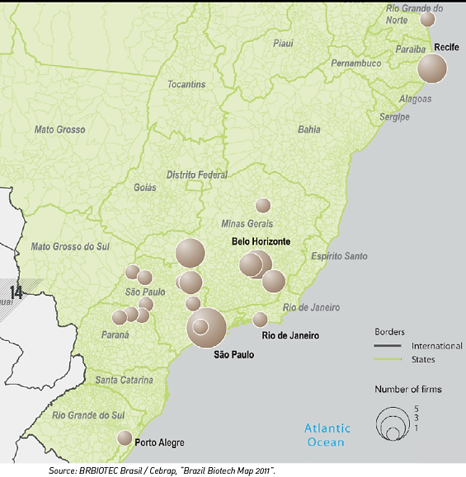


Slide 29
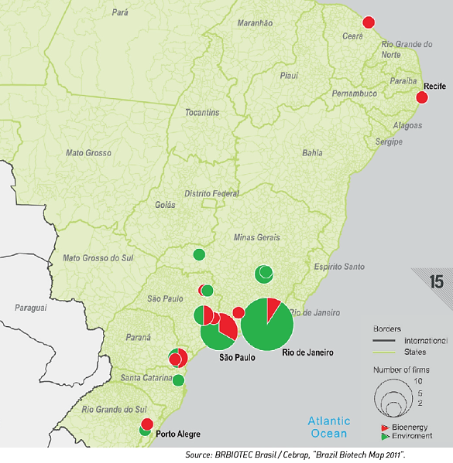

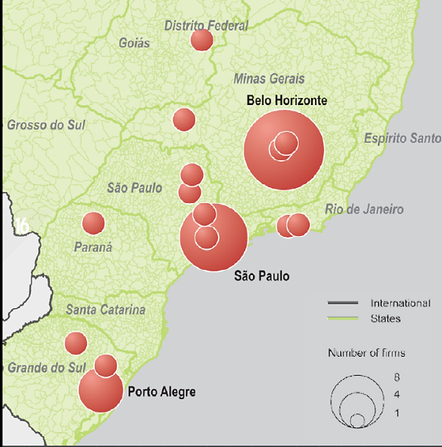

Slide 30
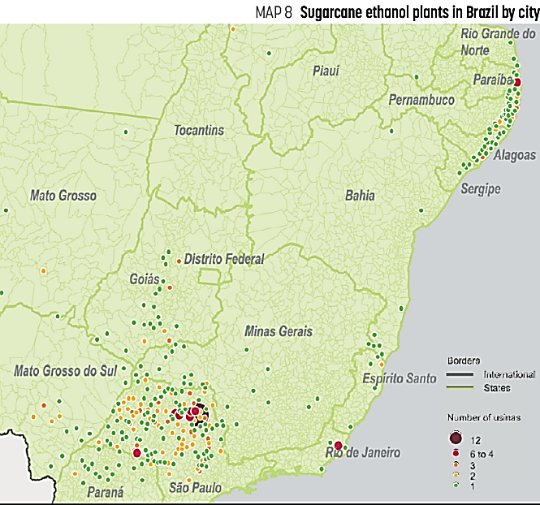
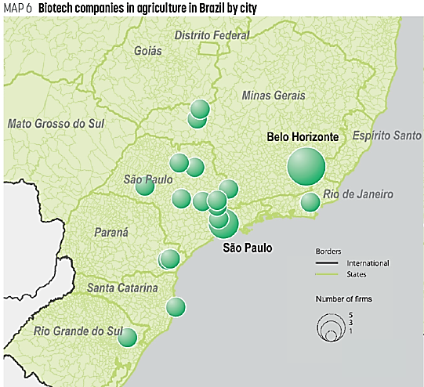

Slide 31
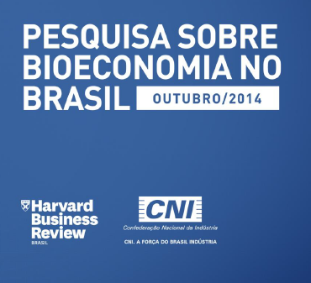

Slide 32
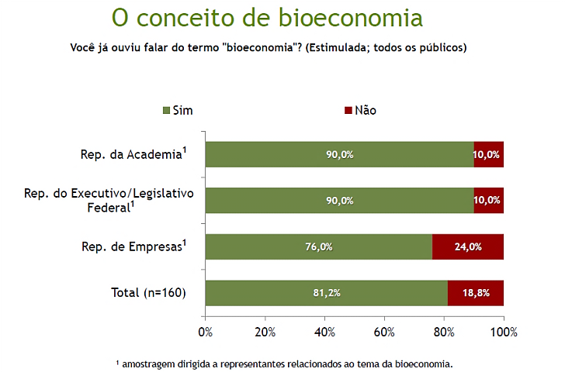

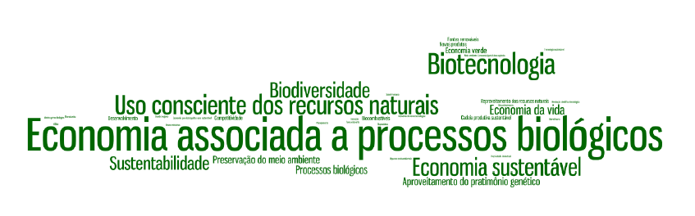
Bioeconomy concept

Slide 33
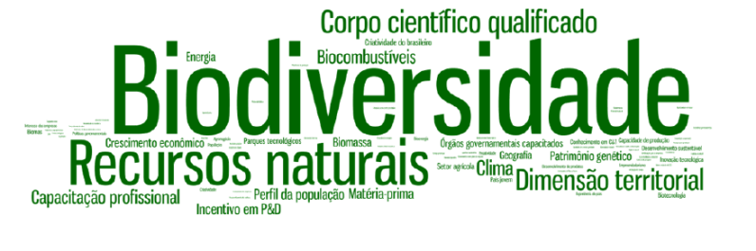
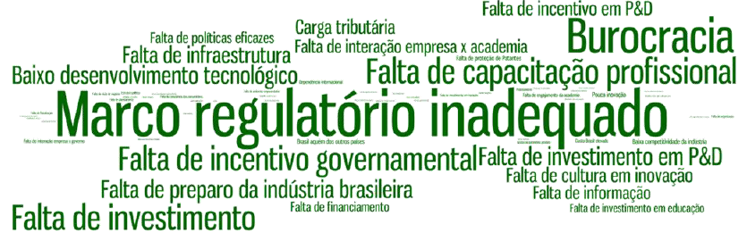
Advantages
Disadvantages

Slide 34
Source: GranBio
Notes:
34
34

Slide 35
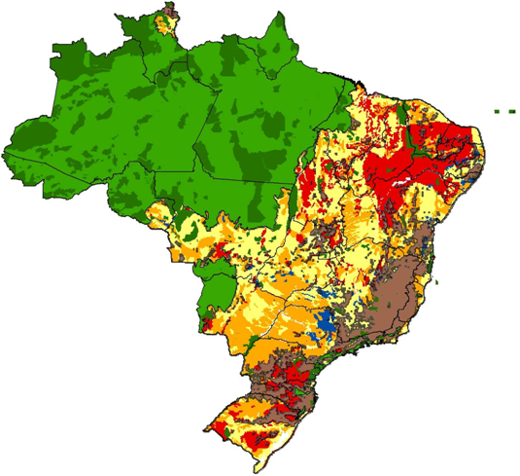
Potential areas for sugarcane production
Soil and climate – without irrigation
Amazon Rainforest
Pantanal
Atlantic Forest
High
Average
Low (World average)
inappropriate
Other important preservation areas
Above 12% slope area
Notes:
35
35

Slide 36
Land Use in Brazil (2010)
Sugarcane uses 3.4% of available agricultural land in Brazil!
Brazil has nearly 40 million hectares of degraded pastures.
Source: IBGE, 2011

Slide 37
Brazilian ethanol production and world oil prices (1970 to 2010)
Source: Oil prices: BP
Brazilian ethanol production: EPE and MAPA
Proálcool

Slide 38
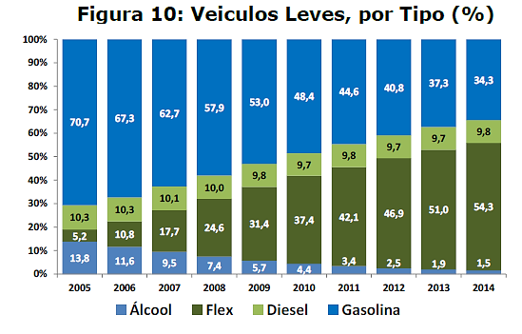
Brazilian light vehicles, by type (%)
Source: MME (2015)

Slide 39
Numbers of the Sugarcane Industry in Brazil
430 mills
Sugarcane producers: 70.000
Jobs directly: 1.2 million
GDP US$ 48 billion
Exports US$ 15 billion
First sugar Producer
25% world production of sugar
50% world exports
Second world bioethanol producer Source: UNICA

Slide 40
Brazil has the advantage of availability and competitiveness of various renewable raw materials segmented into two chains:
Carbohydrates; and
Natural fats and oils.
  Carbohydrates: Brazil has nearly 30% of world production of sugarcane and 40% of corn, which generates two major agro-industrial residues: bagasse and straw.
  Natural oils and fats: The Brazilian share of soybean oil represents 18% of world output.
Source: Bain & Company

Slide 41
Two plants of cellulosic ethanol (straw and bagasse from sugarcane – 2G) in commercial scale started operations in 2014 in Brazil.
GranBio – Alagoas; and
Raízen – São Paulo;
These industrial plants also generate electricity from biomass and industrial waste such as lignin.
Two other plants are under construction and together they will produce 140 million liters of biofuel/year (ethanol 2G).
Source: ABBI

Slide 42
The Brazilian industrial biotechnology sector has advanced in other areas, like diesel and bio-kerosene made from sugar cane and biochemicals.
Amyris began producing since 2013 the first bio-jet fuels made from sugarcane for commercial aviation and provides the sugarcane diesel used by hundreds of buses in São Paulo.
        Besides, Rhodia and GranBio created a joint venture (CGBio) to develop bio n-butanol, a compound used in the manufacture of paints and solvents.
Source: ABBI

Slide 43
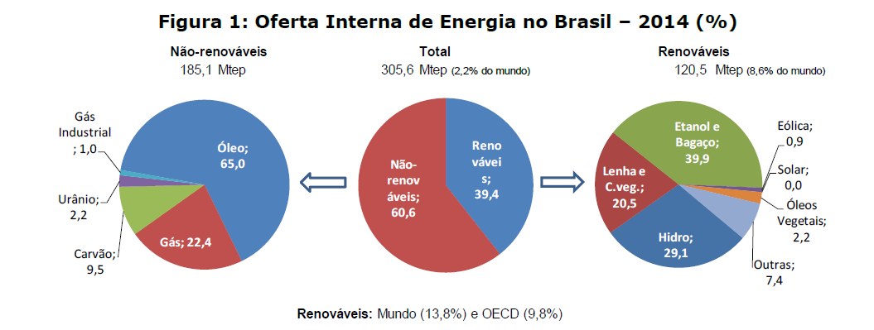
Brazilian energy matrix – 2014

Slide 44
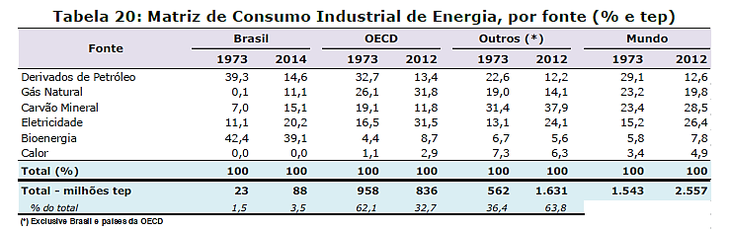
Industrial power consumption, by source
(% tons of oil equivalent)

Slide 45
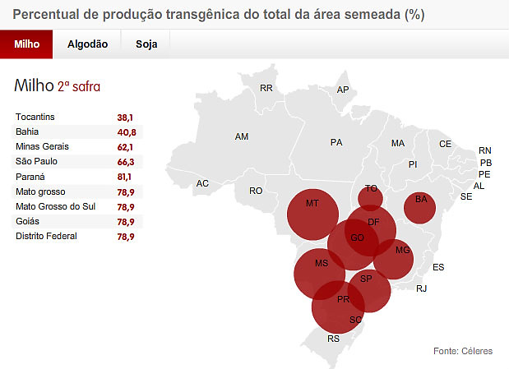
GM production percentage of the total sown area (%)
Corn – 2nd harvest

Slide 46
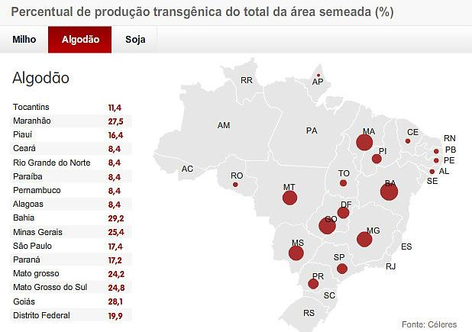
GM production percentage of the total sown area (%)
Cotton

Slide 47
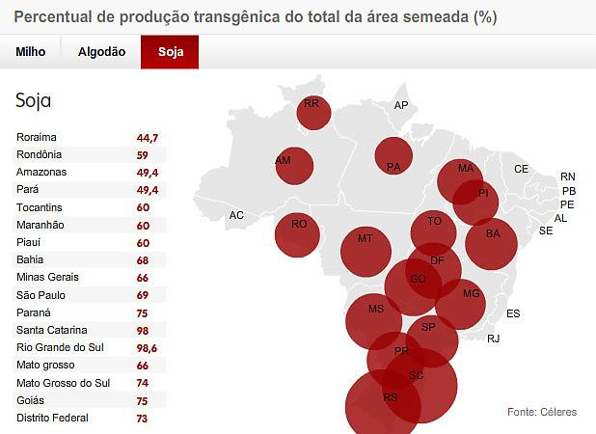
GM production percentage of the total sown area (%)
Soybean
In 2013, for the first time, genetically modified crops surpassed non transgenic crops in Brazil (by area).

Slide 48
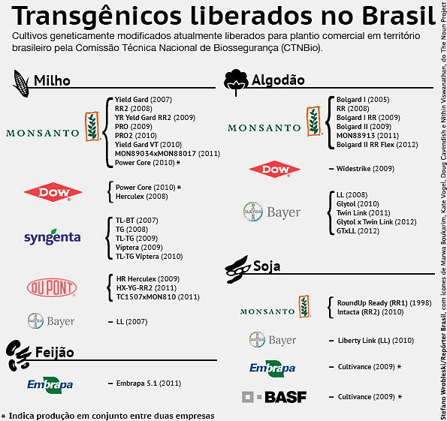
Transgenics released in Brazil

Slide 49
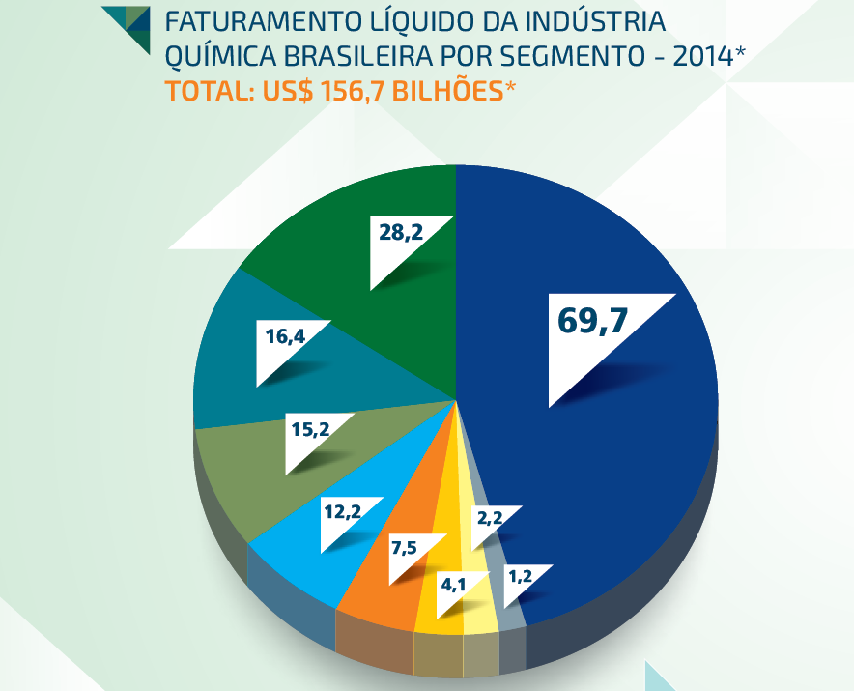
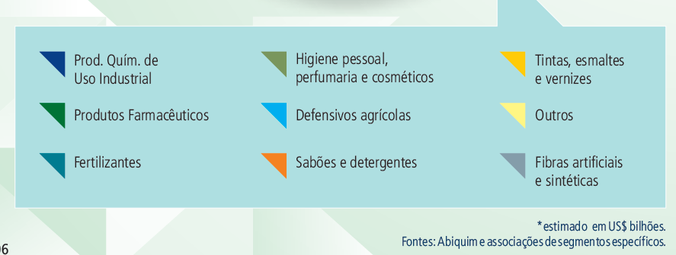


Slide 50
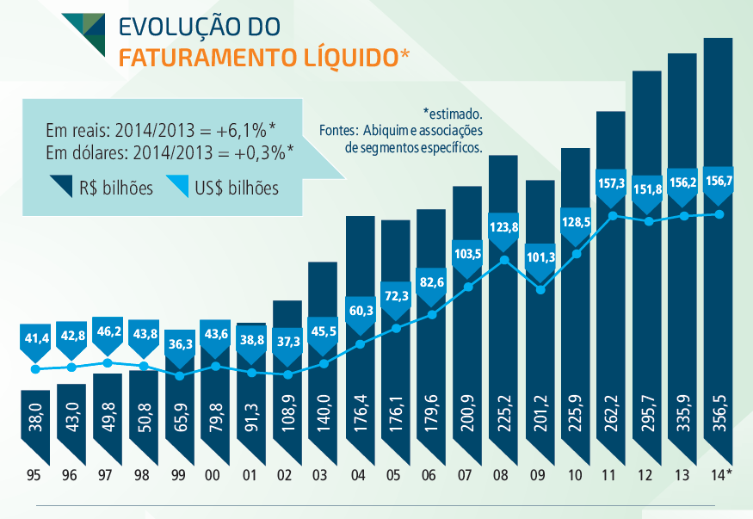

Slide 51
Investment opportunities in the production of chemicals in Brazil using biotechnological routes from renewable sources (notably biomass) can contribute from US$ 15 billion to US$ 35 billion revenue to the industry by 2030.
Source: Bain & Company

Slide 52
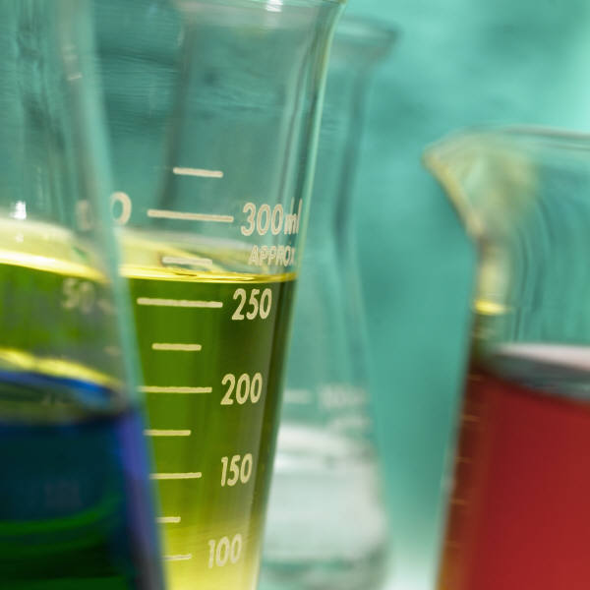
The road to the sustainability of the chemical industry and its products
Produção Química
Química Verde
1920
Controle de acidentes e doenças ocupacionais
1ª Onda
1960
Poluição industrial e resíduos
2ª Onda
1990
Plantas seguras e mais limpas
3ª Onda
2020
Produtos seguros
4ª Onda
20??
Processos e produtos sustentáveis
Segurança Química
Carboquímica
Petroquímica
Nanoquímica e Bioquímica
Source: Abiquim

Slide 53
In eight years, Brazil went from 10th to 6th world pharmaceutical market.
By 2016, Brazil should occupy 4th place in this market.
Source: IMS Health

Slide 55
Partnerships for productive development (PDP):
104 formalized partnerships (until 2014);
97 finished products:
  66 medications;
  7 vaccines;
  19 health products;
  5 R&D.
79 partnerships: 19 public laboratories and 60 privates.
R$ 8.9 billion in public purchases
R$ 4.1 billion/year saved
Source: Intrafarma

Slide 56
Clinical research generates nearly US$ 40 billion in investments/year in the world
In Brazil, this number is about US$ 139 million
Brazil's participation in clinical studies in the world is 1% and occupies the 15th position
Source: ViS Research Institute

Slide 57
In Brazil, a first generation of pharmaceutical biotech products (insulin and growth hormones, etc.) is under development.
Worldwide, the second generation is already under way, and will be the future of the pharmaceutical industry, especially monoclonal antibodies.
Because the first patents of second-generation biotechnology will expire by 2020, there has been a global race to develop, register, and produce 'biological not new’ products and processes.
Source: Abifina

Slide 58
There are seven enabling factors that together create an environment conducive to biotech innovation:
human capital;
infrastructure for R&D;
intellectual property protection;
regulatory environment;
technology transfer framework;
market and commercial incentives; and
legal security (the rule of law).
Source: Pugatch Consilium

Slide 59
Based on that, countries must follow six recommendations:
identify the biotechnology sector as an area of strategic importance;
create a national blueprint;
measure performance;
recognize and use existing best practices;
leverage national capabilities; and
enhance local and international cooperation.
Source: Pugatch Consilium

Slide 60
Brazil has for many years been a pioneer in using and developing GM crops and developing agricultural biotechnology.
And the Brazilian Government, through Embrapa, has for decades been actively involved in the R&D and commercialization of agricultural biotechnologies.
Biotechnology has been identified as a national strategic priority in 2003, culminating in the 2007 decree No. 6,041 (Política de Desenvolvimento da Biotecnologia)
Source: Pugatch Consilium

Slide 61
It is important to note that, in the last 30 years, much of the money generated in the world depended on a unique formula: the price of digital processing.
This price drops by half every 18 months, while the power of digital devices doubles.

Slide 62
In 2006, only 6% of the world's data were digital.
Today, that percentage is 99%.
The countries with companies that surfed this "wave”, became richer – Korea and Singapore, for example.
Once costs decrease and production increases, in the life sciences a similar phenomenon will probably take place.

Slide 63
At first, digital codes were an obscure language used by "nerds", while today they represent a ubiquitous language, used by the whole world.
And this trend is absolutely critical to Brazil, because nowadays many of our products, sectors where we are competitive, and exports are already being changed by the life sciences.
Furthermore, the trend seems irreversible in Brazil, as well as worldwide, as we have tried to illustrate.

Slide 64
The life sciences are beginning to permeate, change, and drive more and more areas of the economy.
It is important that Latin America understands, adopts, adapts and takes a leading role in these changes, just as Singapore and Korea did decades ago in the emerging digital revolution.
It not enough to have biodiversity. It is necessary to address the obstacles and develop the skills that will transform it into knowledge and wealth!

Slide 65
Sustainable Bioenergy: Latin America & Africa
http://bioenfapesp.org/scopebioenergy/indexphp/policy-brief/2018
Thanks for your attention!
carlos.aragao51@gmail.com
carlos.aragao@marinha.mil.br

