Slide 1
R&D and Innovation South America
Dr.-Ing. Antonio Sergio Medeiros Fonseca
Superintendente
09 Nov-2018

Slide 2









Vallourec Open Brazil 2017 Data Science
Open Innovation
Activated Ecosystems on Universities
UFRJ
UFMG
UFJF
UFF
UNIFEI
PUC-RIO
Selected Startups
Artificial Intelligence Technology: Neural Network solution originally developed to flexible risers was successfully adapted to rigid ones
Data qualification algorithms: to identify failures on data storage and enable feasible data mining

Slide 3

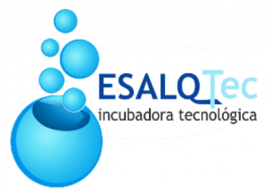
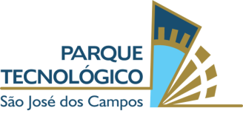

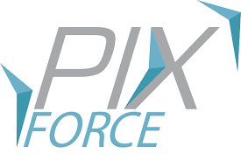

Vallourec Open Brazil 2018 Computational Vison
Open Innovation
Activated Ecosystems on Universities
UFRJ
UFMG
ESALQ/USP
UFJF
UFF
CTA/ITA
UNIFEI
PUC-RIO
INATEL
Selected Startups
Challenge: Evaluation of forest quality and health
Solution: Use of satellite images and machine learning to identify and emit alerts about anomalies in the forests
Challenge: Quantification of the wood charged in the furnace and stored in the field
Solution: Development of two systems to measure the wood volume and the stacking factor: one based on drone images and the other on tablet images.

Slide 4







Open Innovation
Open innovation program in partnership with SEBRAE
Mind 4.0 Industry 4.0
Activated Ecosystems on Universities
The Universities were indirect activated through disclosure
on startups platforms and on innovation events.
Selected Startups
Challenges :
Traceability, position control and amount optimization of maintenance spare parts
Integration of traceability technologies between clients and suppliers
Identification of iron billets position in stockyard and planning/control of their location
Current step: Service Design – plan and execution of proves of concept

Slide 5









Open Innovation
Vallourec Startup Days
Objective:
promote the matchmaking between VSB internal clients and pre-selected startups. Topics of 2018:
Logistics
People Analytics and Energy
UFRJ Incubator
Legal
Selected Startups

Slide 6
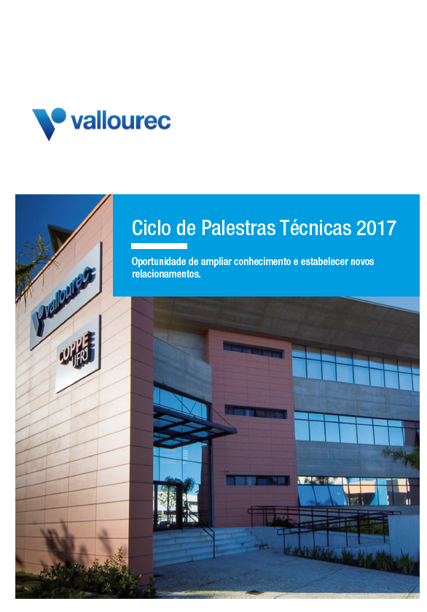
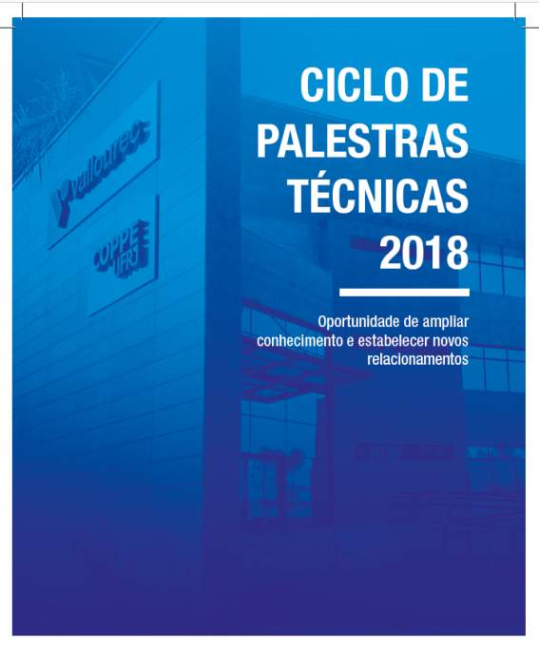
Open Innovation
Technical Seminars VCC - Rio
University Professors and Research Center Directors are invited to present their fields of expertise, ongoing research and innovation activities and lab equipment and resources.
Companies are invited to present their challenges to the Academia.
Goals
Enlarge Scientific Knowledge
Create/Increase technical networking
Generate new ideas/ open innovation
Greater visibility of VCC-Rio & VSB in RD&I ecosystems
Identify possibilities of future partnerships
INNOVATION
VCC-Rio – Sylvestre Silva

Slide 7
Open Innovation
Technical Seminars VCC-Rio 2017 : 8 topics
Date | Seminars | Professors | Institution
Jun/17 | Trends on the development of New Materials | Fernando Rizzo | (INT/PUC-RJ)
Aug/17 | Flow of complex fluids in porous materials: application on oil recovery | Márcio Carvalho | (PUC-RJ)
Sep/17 | Laboratory facilities and capacity for preparing and characterization of alloys - Integrated flowchart | Luiz Henrique de Almeida | (COPPE/UFRJ)
 | Analytical potential of COPPE’s electronic microscopy center | Paula Jardim | (COPPE/UFRJ)
 | Materials degradation - Hydrogen embrittlement | Dilson dos Santos | (COPPE/UFRJ)
 | Microstructural characterization using magnetic methods | Gabriela Pereira | (COPPE/UFRJ)
Oct/17 | Structural steel (Gr. X-65) behavior after exposure to hydrogen | Marcos Pereira | (PUC-RJ)
Dec/17 | Applications of Thermo-elastic techniques (TSA) for determination of stresses and fatigue strength | José Luiz Freire | (PUC-RJ)

Slide 8
Open Innovation
Technical Seminars VCC-Rio 2018 : 14 topics
Date | Seminars | Professors | Institution
Mar/18 | Entrepreneurship, innovation and technology transfer | Maria Luísa Coutinho | (Univ. de Coimbra - PT)
Apr/18 | Tube welding for oil and gas industry | João Payão Filho | (COPPE/UFRJ)
Mai/18 | NDT: A Science of solutions – its history in DMM/PEMM/UFRJ | João Marcos Rebello | (COPPE/UFRJ)
 | New frontiers for non-destructive testing techniques | Gabriela Pereira | (COPPE/UFRJ)
 | Advances in radiography and X-ray tomography techniques for industry | Ricardo Lopes | (COPPE/UFRJ)
Jun/18 | Nanotechnology in oil and gas industry | Sérgio Camargo | (COPPE/UFRJ)
Aug/18 | Corrosion in oil and gas sectors. Activities developed by LABCORR/COPPE/UFRJ | José Ponciano | (COPPE/UFRJ)
Sep/18 | Friction reduction in pipelines | Luis Fernando Azevedo | (PUC-RJ)

Slide 9
Open Innovation
Technical Seminars VCC-Rio 2018 : 14 topics
Date | Seminars | Researchers / Professors | Institution
Oct/18 | Technological challenges – corporate presentations
 | Innovation through technological partnerships | Eduardo Fernando | Petrobras
 | Intelligent completion: a multidisciplinary view of the technological challenges faced in the pre-salt | Desiderio Naegele | Halliburton
 | MindSphere - transforming data into knowledge and knowledge into successful business | Vinicius Oliveira | Siemens
 | Current Challenges in Computing Research and Information Technology Infrastructure | Jonas Dias | EMC/Dell
 | The pre-salt and commitment to combine high mechanical resistance with corrosion resistance for coating tubes | Daniel Guerra | Vallourec
Nov/18 | Use of Computational Thermodynamics to develop steels for advanced applications | André Costa e Silva | (UFF-RJ)

Slide 10



Contact: antoniosm.fonseca@vallourec.com
Vallourec.com
07/11/2018
CHARTE POWERPOINT HAVAS PARIS POUR VALLOUREC
10

